Slide 1

Design of a Smart American Sign Language Translator
Presenter: Josheb Dayrit

Slide 2
Background
Deaf individuals experience worse psychological and physical health relative to their hearing counterparts (Fellinger, Holzinger, & Pollard, 2012; Fellinger, Holzinger, Sattel, & Laucht, 2008; Kvam, Loeb, & Tambs, 2007; van Eldik, 2005; Van Gent, Goedhart, Hindley, & Treffers, 2007).
Higher rates of impulse control disorders, depressive symptoms, and developmental disorders have been recorded in deaf populations (Fellinger et al., 2012).
Similarly, deaf individuals report worse rates of physical well-being and are less likely to utilize health care systems than hearing individuals (Alexander, Ladd, & Powell, 2012; Barnett & Franks, 2002; Barnett, McKee, Smith, & Pearson, 2011; Pick, 2013)

Slide 3
Objective
To design a smart ASL translator that will help facilitate basic conversations between the deaf and non-deaf.

Slide 4
Design Requirements
The final product is a gesture-by-gesture translator.
The final product can translate 100 gestures.
The final product can identify gestures with at least 70 percent accuracy.
The final product will have gesture-to-speech and speech-to-text features.
The final product will have a GUI users can interact with.

Slide 5
Design Constraints
Some gestures are not arm-based or hand-based, which means that they cannot be reliably measured by certain sensors (i.e. EMG sensors).
If the neural network will be hosted locally, it must run on a device that possesses sufficient storage as well as processing power.
There are no pre-made datasets that can be used to train my neural network.
Wireless internet connection will be necessary to access text-to-speech and speech-to-text APIs.

Slide 6
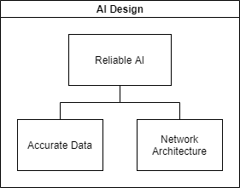
Design Method (AI)

Slide 7
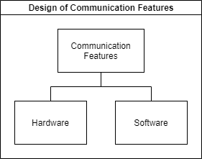
Design Method (Communication Features)

Slide 8
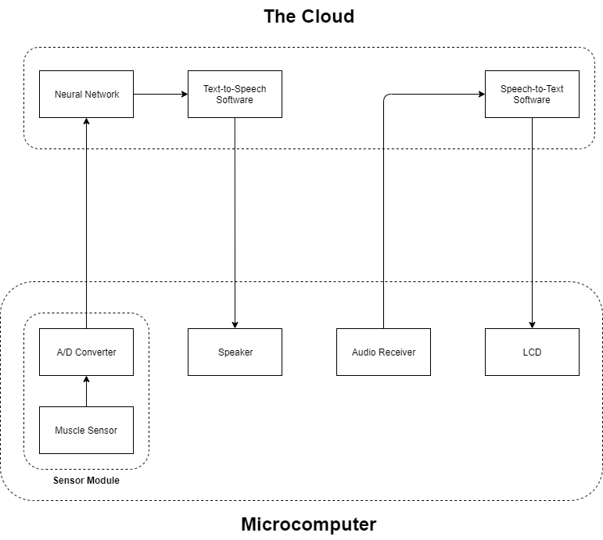
System Diagram

Slide 9
Tasks
Data Acquisition and Data Processing
Neural Network Design
Neural Network Implementation
Design of Gesture-to-Speech Feature
Design of Speech-to-Text Feature
Design of GUI

Slide 10
Task 1: Data Acquisition
Subtask 1.1: Interface computing devices and sensing devices.
Subtask 1.2: Write code to automatically document all sensor outputs.
Subtask 1.3: Write code to automatically format data for use in a neural network.

Slide 11
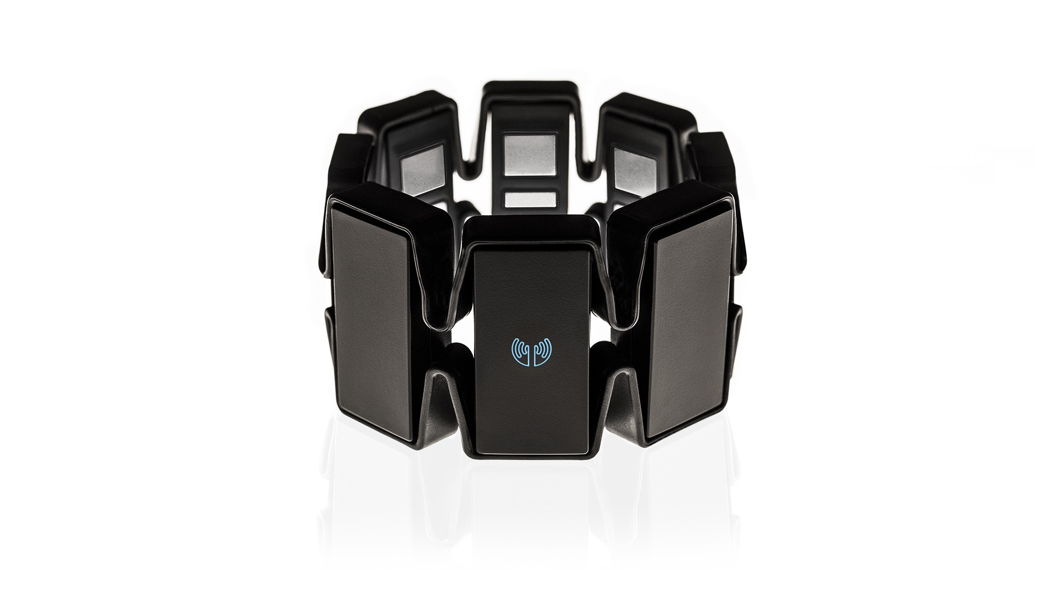
Myo Armband
Myo Armband developed by Thalmic Labs

Slide 12
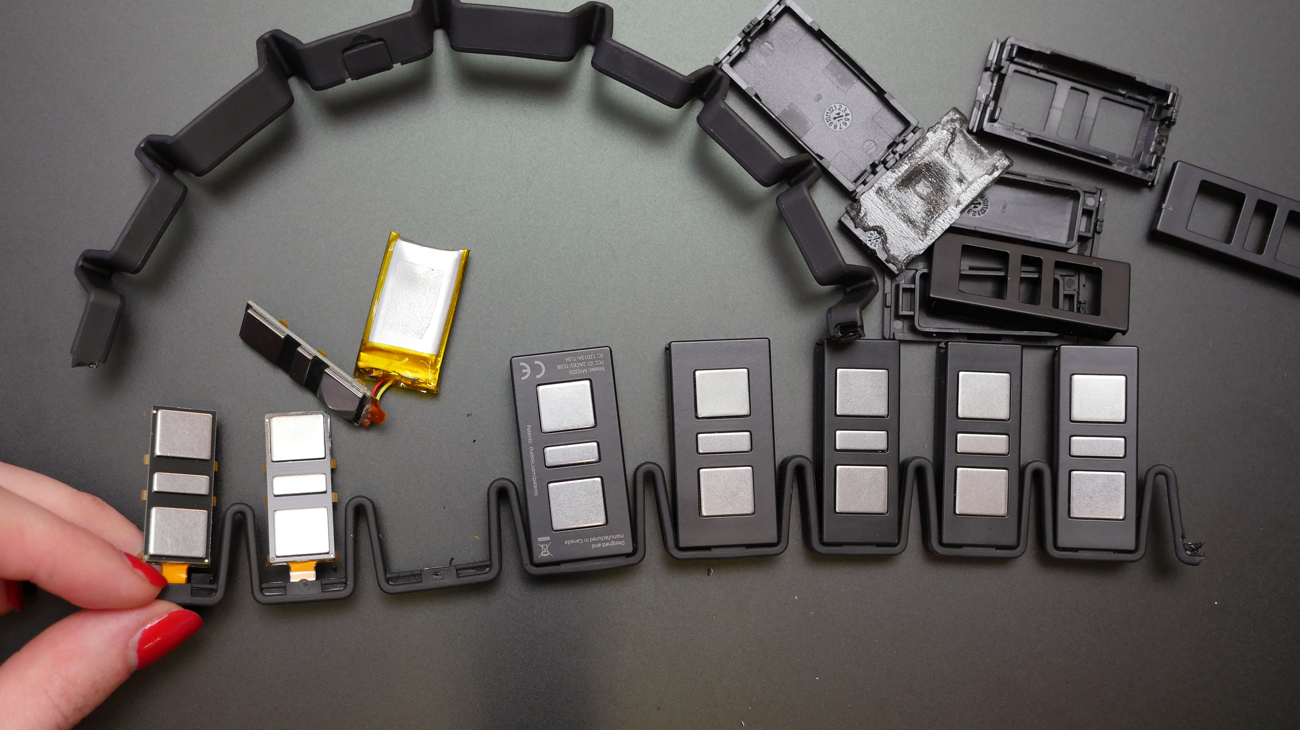
Myo’s 8 EMG Sensor Modules
8 EMG sensor modules for 8 different forearm EMG readings

Slide 13
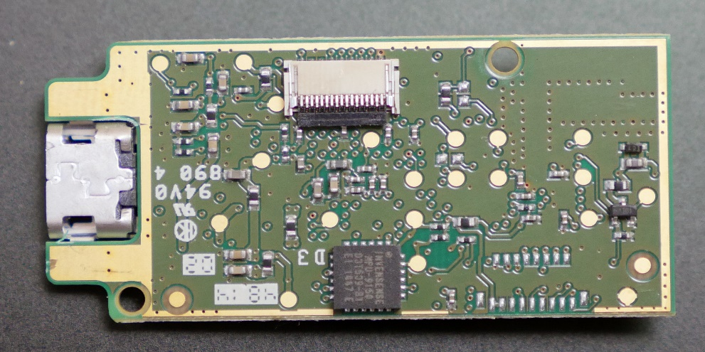
Invensense IMU Chip
9-axis IMU (all-in-one gyroscope, accelerometer, and magnetometer)

Slide 14
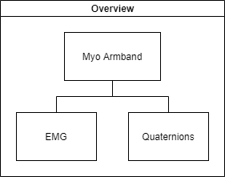
Data Acquired from Myo Armband

Slide 15
More about Myo Armband
The EMG sensors are sampled at 200 Hz.
The 9-axis IMU is sampled at 50 Hz.
The EMG sensors produce pre-processed readings which range from -128 to 127.

Slide 16
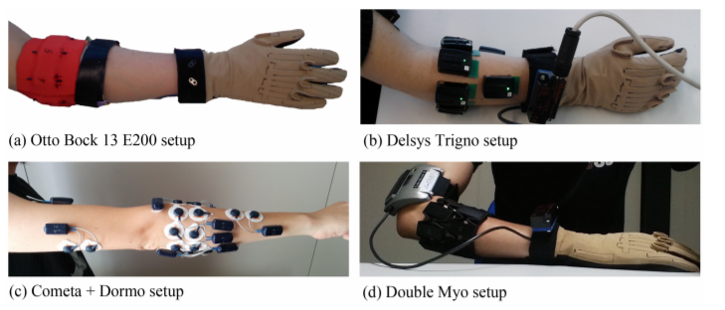
Myo Armband Used in Academia
From “Comparison of Six Electromyography Acquisition Setups on Hand Movement Classification Tasks” by Pizzolato et al.

Slide 17
About Study by Pizzolato et al.
The study wanted to classify 41 different hand movements.
Two machine learning models were developed, each with a different algorithm.
The models were trained with data from 4 different sensors.
The performance of the models was used to compare the reliability of the sensors for gesture classification.

Slide 18
Results
“The results of the standardized classification procedure are reported in Fig 5. As previously described, the results need to be compared only with sEMG classification problems targeting a similar number of classes with a balanced approach. The best results are obtained on the 2nd dataset with the Delsys Trigno setup (74.01% ± 7.59% considering the matched group of 10 subjects, 72.25% ± 7.13% considering all 40 subjects). Comparable average accuracies are obtained in DB4 with the Cometa and Dormo acquisition setup (69.13% ± 7.77%) and in DB5-All with the double Myo acquisition setup (69.04% ± 5.24%).” [pp.13].

Slide 19
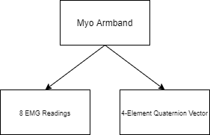
Extracting Data from the Myo Armband

Slide 20
Data Extraction through Bluetooth / Myo Python
The Myo armband comes with a Bluetooth USB that can be plugged in to a computing device.
The Myo Python library has functions to allow EMG and orientation data to be acquired from Myo armband via Bluetooth.

Slide 21
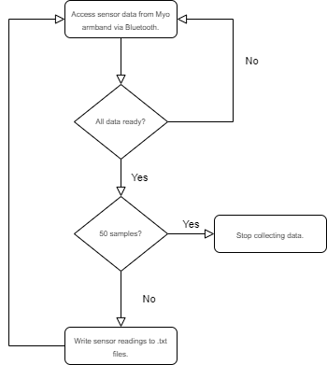
Data-Logging with Myo Python (Flowchart)

Slide 22
Data-Logging (Implementation)
if self.orientation and self.emg: # get orientation data. for element in self.orientation: quaternions_read.append(element) instances_quat = instances_quat - 1 if instances_quat == 0: quat_w.write(str(quaternions_read[0]) + ' ') quat_i.write(str(quaternions_read[1]) + ' ') quat_j.write(str(quaternions_read[2]) + ' ') quat_k.write(str(quaternions_read[3]) + ' ') # get EMG data. for element in self.emg: emg_read.append(element) instances_emg = instances_emg - 1 if instances_emg == 0: emgPod_1.write(str(emg_read[0]) + ' ') emgPod_2.write(str(emg_read[1]) + ' ') emgPod_3.write(str(emg_read[2]) + ' ') emgPod_4.write(str(emg_read[3]) + ' ') emgPod_5.write(str(emg_read[4]) + ' ') emgPod_6.write(str(emg_read[5]) + ' ') emgPod_7.write(str(emg_read[6]) + ' ') emgPod_8.write(str(emg_read[7]) + ' ')

Slide 23
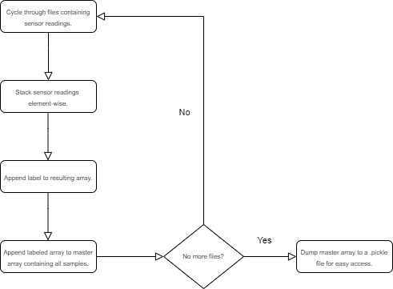
Format Data for Use in Neural Network (Flowchart)

Slide 24
Format Data for Use in Neural Network (Implementation)
for paths in main_paths: for num in tqdm(range(count)): # loads all data. emgPod1 = np.loadtxt(paths + '\\' + data[0] + '\\' + data[0] + '_' + str(num + 1) + '.txt') emgPod2 = np.loadtxt(paths + '\\' + data[1] + '\\' + data[1] + '_' + str(num + 1) + '.txt') emgPod3 = np.loadtxt(paths + '\\' + data[2] + '\\' + data[2] + '_' + str(num + 1) + '.txt') emgPod4 = np.loadtxt(paths + '\\' + data[3] + '\\' + data[3] + '_' + str(num + 1) + '.txt') emgPod5 = np.loadtxt(paths + '\\' + data[4] + '\\' + data[4] + '_' + str(num + 1) + '.txt') emgPod6 = np.loadtxt(paths + '\\' + data[5] + '\\' + data[5] + '_' + str(num + 1) + '.txt') emgPod7 = np.loadtxt(paths + '\\' + data[6] + '\\' + data[6] + '_' + str(num + 1) + '.txt') emgPod8 = np.loadtxt(paths + '\\' + data[7] + '\\' + data[7] + '_' + str(num + 1) + '.txt') quaternion_i = np.loadtxt(paths + '\\' + data[8] + '\\' + data[8] + '_' + str(num + 1) + '.txt') quaternion_j = np.loadtxt(paths + '\\' + data[9] + '\\' + data[9] + '_' + str(num + 1) + '.txt') quaternion_k = np.loadtxt(paths + '\\' + data[10] + '\\' + data[10] + '_' + str(num + 1) + '.txt') quaternion_w = np.loadtxt(paths + '\\' + data[11] + '\\' + data[11] + '_' + str(num + 1) + '.txt') # stacks data element-wise. stacked_data = np.dstack((emgPod1, emgPod2, emgPod3, emgPod4, emgPod5, emgPod6, emgPod7, emgPod8, quaternion_i, quaternion_j, quaternion_k, quaternion_w)) # appends solutions to corresponding data samples. training_data.append([stacked_data, gestureAsIndex])

Slide 25
Task 2: Neural Network Design
Subtask 2.1: Propose a data visualization method for sensor data.
Subtask 2.2: Determine a suitable neural network architecture for the project.
Subtask 2.3: Verify the feasibility of the proposed data visualization method and neural network architecture.

Slide 26

Neural Network Overview

Slide 27
Neural Network Overview
Neural network = mathematical model of the human brain.
The brain lobes = layers in a neural network.
Neurons = nodes in a neural network.
Brain processes and interprets information in five ways (by taste, sound, touch, smell, and sight).
Neural network processes and interprets information in one way: numerically.

Slide 28
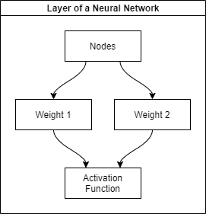
How the Neural Network Works

Slide 29
Weights and Activation Function / Correlation to the Brain
Weight = the strength of connections between neurons.
Activation function = the rate of action potential (determines if a neuron transmits information, and how fast it transmits said information).

Slide 30
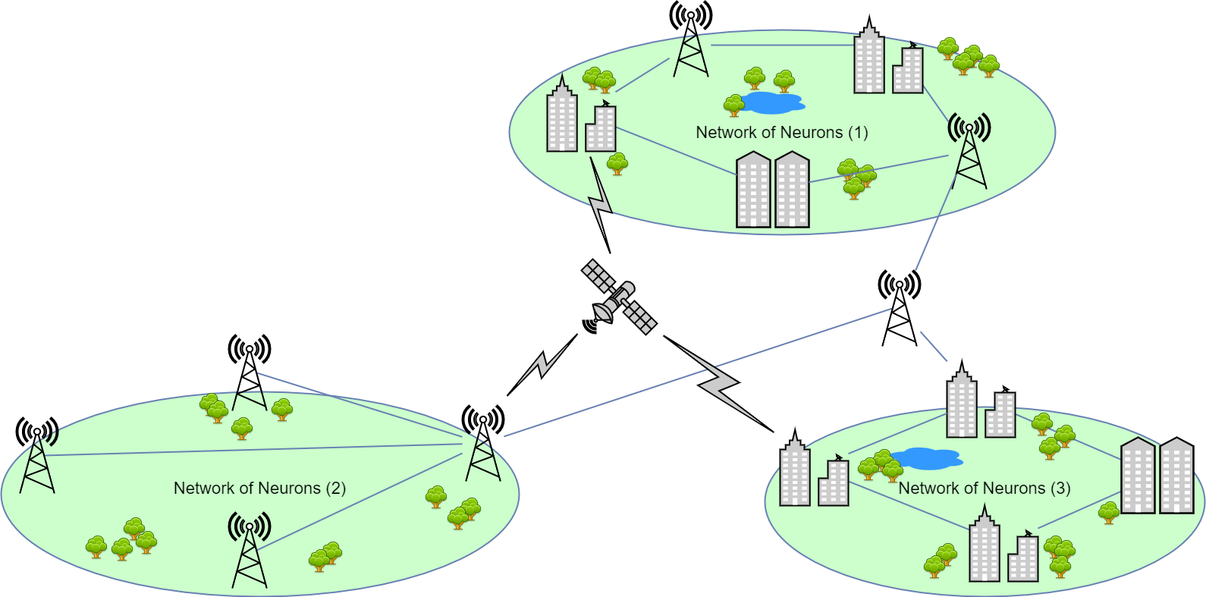
Weights / Strength of Connections Between Neurons
Responsive
Neutral
Unresponsive
Network 1 likes dogs, network 2 likes cats, and network is fine with either one.

Slide 31
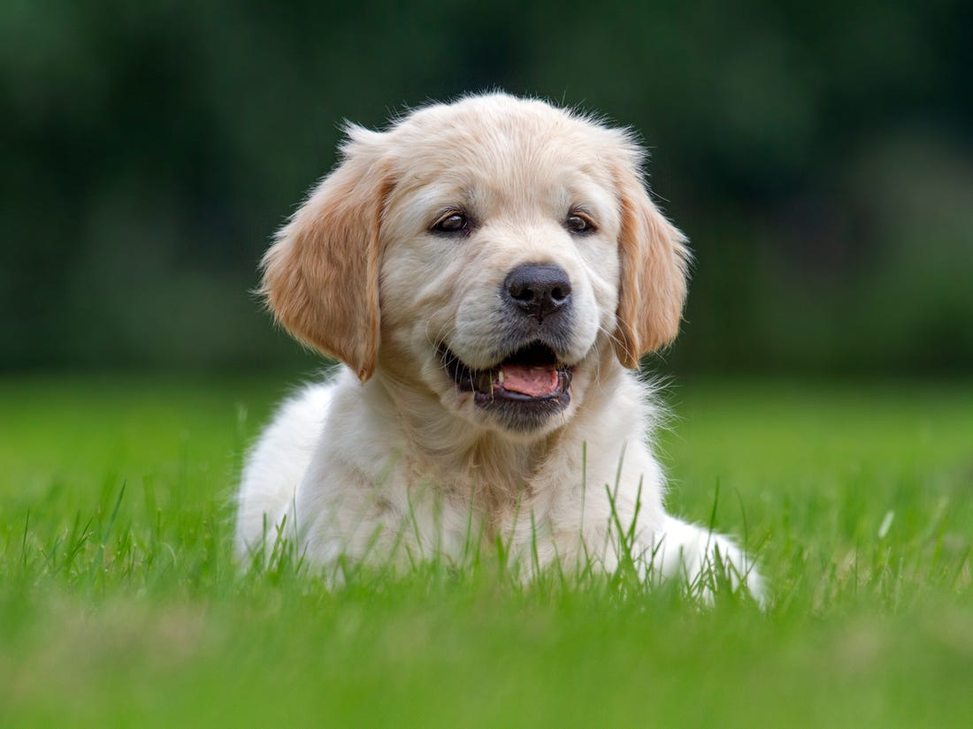
Incoming Stimulus

Slide 32
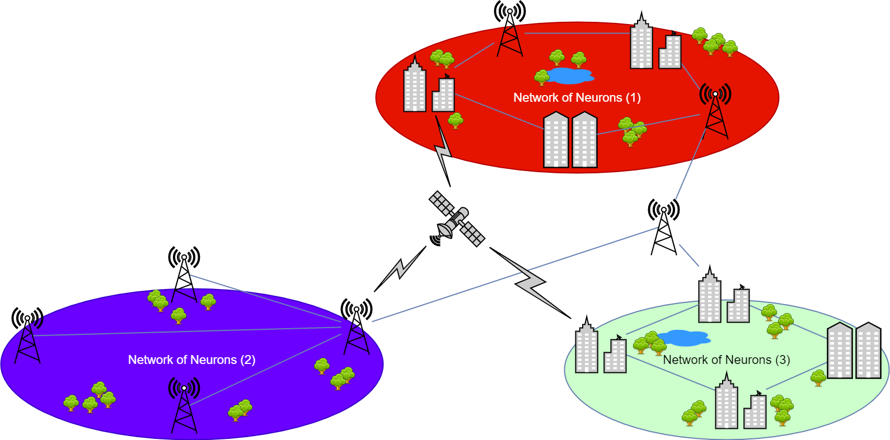
Response

Slide 33
Importance of Weights
Weights determines responsiveness of our neural network to different stimulus.
We train our network because we want to tune its weights.
We want our network to be responsive in different ways to different gestures.

Slide 34
Data and the Neural Network
We are processing time-series data.
The neural network should be compatible to the type of data it will process.

Slide 35
LSTM (Long Short Term Memory) Model
The LSTM is a type of RNN (recurrent neural network).
Their specialty is memorizing long-term dependencies or patterns in data.

Slide 36

Overview of the LSTM Model
From “Understanding LSTMs” by Colah

Slide 37

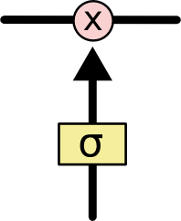
Cell State / Memorization of Past Information
(1) Cell State
(2) Gate

Slide 38
Cell State / Memorization of Past Information
The cell state C(t) is an additional output produced by a layer in an LSTM model.
The job of the cell state is to keep track of changes in the input.
The gates are activation functions that decide if the cell state should be updated.
The cell state enables the LSTM model to memorize long-term patterns in data.

Slide 39
Feasibility of LSTM Model
Is the LSTM model suitable for gesture recognition?
Yes. It will able to memorize trends in EMG and orientation data via the cell state.

Slide 40
Task 3: Neural Network Implementation
Subtask 3.1: Create a TensorFlow model based on the results of Task 1.
Subtask 3.2: Train the TensorFlow model using acquired sensor data.
Subtask 3.3: Refine the TensorFlow model to optimize performance.

Slide 41
Defining a Model Using the Keras API for Tensorflow
Keras API simplifies model building in Tensorflow.
Models are defined sequentially, layer-by-layer, using model.add().
Hyperparameters (nodes, activation functions etc.) can be defined as arguments to the model.add() function.

Slide 42
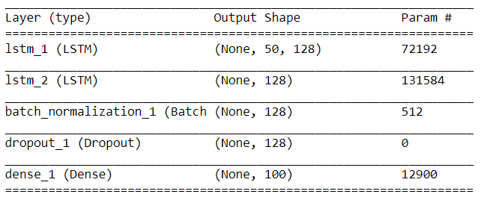
Current Iteration of LSTM Model

Slide 43
Stacked LSTM Layers
Why stack LSTM layers?
“… building a deep RNN by stacking multiple recurrent hidden states on top of each other. This approach potentially allows the hidden state at each level to operate at different timescale.”
Excerpt from “How to Construct Deep Recurrent Neural Networks” by Bengio et al.
The recurrent hidden state = the cell state of the LSTM layer.
The benefit of stacked LSTM layers is analysis by chunking: the processing of input data chunk-by-chunk as opposed to all at once.
Chunking leads to deeper understanding of trends in data.

Slide 44
Dropout
The dropout layer is not a processing layer. It does not process data.
The dropout layer adds noise to data by disabling nodes from layers.
The job of the dropout layer is to reduce overfitting (i.e. weights are too specific).

Slide 45
Batch Normalization
Like the dropout layer, the Batch Normalization layer does not process data.
Its job is to rescale data to have a mean of 0 and standard deviation of 1. All data is within the same range of values.
Benefits:
Weights do not change very drastically.
No erratic changes in model performance during training.

Slide 46
Model Performance
The model was trained using 8000 samples.
The model was tested using 2000 samples.
Early stopping was implemented to stop training if performance stagnates and save the state of the model at peak performance (test loss is low and test accuracy is high).
Batch size was set at 64 (64 samples processed at a time), and the ADAM optimizer was used with 0.001 learning rate.

Slide 47
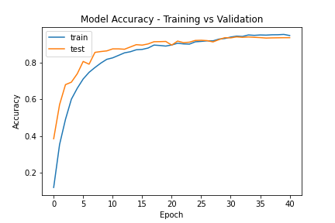
Model Performance

Slide 48
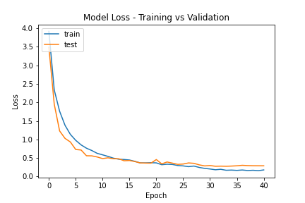
Model Performance

Slide 49
Model Evaluation
Loss is a measure of the number of mistakes your model has made during training or testing. It is used to determine if model is overfit (weights are tuned to be too specific) or underfit (weights are tuned to be too general).
Our model is showing signs of overfitting, since test loss > training loss.
Possible explanations for overfitting:
Neural network architecture has too many layers.
The neural network is training for too long (too many training cycles).
Rule of thumb for overfitting:
If the training dataset is processed by the network, it will memorize the data by having weights meant to identify samples in the training dataset. This leads to poor performance on the testing dataset.

Slide 50
Task 4: Design of Gesture/Text-to-Speech Feature
Google Voice will be used for voice-synthesizing.
The Playsound library (cross-platform, usable for Windows, Mac, and Linux operating systems) will be used to play the sound file generated by Google Voice.

Slide 51
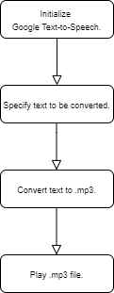
Gesture/Text-to-Speech (Flowchart)

Slide 52
Gesture/Text-to-Speech (Implementation)
from gtts import gTTS
from playsound import playsound
import os
import numpy as np
def getTTSoutput():
gesture = str(np.genfromtxt("output_gesture.txt", dtype="str"))
sound_file = "output_TTS.mp3"
# passes text to Google Voice.
tts = gTTS(text=gesture, lang="en")
# saves text as .mp3.
tts.save(sound_file)
# play .wav file via playsound.
playsound(sound_file)
# deletes sound file after use.
os.remove(sound_file)
getTTSoutput()

Slide 53
Task 5: Design of Speech-to-Text Feature
The speech recognition library developed by Andrew Zhang will be used to perform speech-to-text conversion.
Wi-Fi will be necessary as the speech-to-text conversion is done through the Google Cloud Speech API.

Slide 54
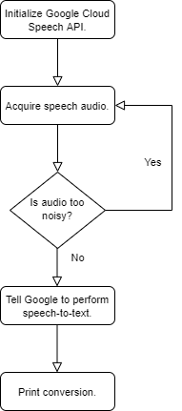
Speech-to-Text Feature (Flowchart)

Slide 55
Speech-to-Text Implementation
import speech_recognition as STT
def speech2text():
# initialize gTTS.
converter = STT.Recognizer()
with STT.Microphone() as sound:
# filter out noise when audio is received.
converter.adjust_for_ambient_noise(sound)
# acquire audio.
output = converter.listen(sound)
# store converted output in 'speech' variable.
try:
speech = converter.recognize_google(output)
except:
speech = 'Try again'
return speech

Slide 56
Task 6: Design of GUI
When developing a graphical user interface (or GUI for short), both form and function go hand-in-hand.
In terms of form, a GUI should be easy-to-navigate.
In terms of function, it should require as little heavy lifting or accommodation from the user as possible.
It was decided that the GUI for Sign AI will be simple and fulfill 3 basic functions:
acquiring sensor data from the Myo armband,
sending sensor data to the neural network for processing,
and acquiring speech data to be converted to text (and vice-versa) by Google APIs.

Slide 57
The Tkinter Library
Since the GUI will be written using the Python language, the Tkinter library will be used to develop it.
The Tkinter library compiles and adapts the Tk GIU toolkit written in its language to Python.
One main benefit of using Tkinter for GUI development is that it is a cross-platform library, meaning that GUIs spawned from it can be run on Microsoft, Linux, and Apple operating systems.
It is also equipped with all the traditional UI elements found in most GUIs such as buttons, drop-downs, and checkboxes.

Slide 58
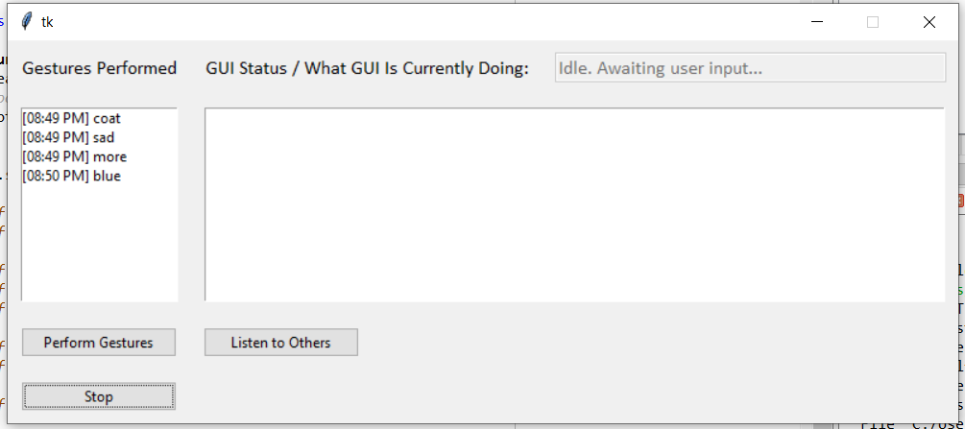
Finalized GUI Design

Slide 59
Discussion on GUI Features
The list-boxes keep track of all outputs produced, giving each a timestamp.
The “Speak” button interfaces with the Myo Armband for data acquisition, neural network for gesture classification, and Google’s Text-to-Speech API for voicing the output.
The “Listen” button executes the script for speech-to-text conversion.
The “Stop” button stops all running programs. The Status Message box lets users know what the GUI is currently doing.

Slide 60
Programming the GUI
In Python, making GUIs that call long-running processes (i.e. data acquisition from Myo) through button clicks is not as straightforward as it seems.
This is because Tkinter GUIs are not capable of performing asynchronous tasks without outside help.
If the GUI does not regularly receive the request to update itself, it will become unresponsive.
To allow my GUI to call a long-running process, I decided to use the multiprocessing library in conjunction with implementing a queue where outputs from long-running processes are polled periodically.
The multiprocessing library will allow my GUI to bypass Python’s global interpreter lock (GIL) and spawn concurrent processes. Recall that the GIL prevents Python from running multiple threads at once.
This approach is successful because the GUI is not running the subprocess inside the loop where it is supposed to update UI elements.

Slide 61
System Testing and Discussion on Results
Table 1: Assessment of Performance through Measuring Number of Translation Attempts
First 3 Attempts | Between 5 to 10 Attempts | Beyond 10 Attempts
Sister, brother, aunt, uncle, separate, day, hot, cold, hamburger, egg, fork, hungry, socks, shoes, coat, hurt, bathroom, sleep, sad, sorry, bad, excuse, help, who, where, big, tall, full, more, blue, yellow, red, brown, orange, cost, bird, horse, sheep, pig, bug | Gold, silver, drink, spoon, angry, single, home, work, school, store, church, come, go, in, out, with, night, week, year, today, finish, hotdog, apple, cheese, cup, cereal, water, candy, cookie, cat | Mom, dad, marriage, grandma, grandpa, baby, pants, underwear, brush, nice, cry, like, good, love, please, thank you, what, when, why, how, stop, green, dollars, dog, cow, children, future, here, milk

Slide 62
Assessing Performance through Number of Translation Attempts
Table 1 splits up all 100 gestures in 3 categories: first 3 attempts, between 5 to 10 attempts, and beyond 10 attempts.
Each category describes the number of attempts that were needed to get a correct translation of a gesture.
Gestures belonging in the first category were gestures which the neural network was easily able to recognize.
Most if not all the gestures in the category were recognized on the first attempt.
Meanwhile, gestures belonging in the second category were gestures which the neural network was capable of recognizing, but with a little more difficulty.
On the other hand, gestures belonging in the final category were gestures which the neural network consistently mis-predicted.

Slide 63
Assessing Performance through a Different Metric
Table 2: Evaluation of the Accuracy of Gesture Detection in First Attempt
Trial Number | Correctly-Guessed Gestures (Out of 100)
1 | 46
2 | 55
3 | 44
4 | 53
5 | 48
Average | 49

Slide 64
Discussing the Results of Table 2
The accuracy of Sign AI in determining a gesture on its first try was also tested.
The test was done a total of 5 times, with each gesture performed just once.
The average number of gestures that Sign AI could guess correctly was 49.
As expected, while performing the test, most of the gestures that were guessed correctly on the first try were the gestures that belonged in the first category of Table 1.
In most of the trials, these gestures were guessed correctly by the neural network.
On the other hand, there were times when the neural network guessed gestures in categories 2 and 3 (albeit, with lesser frequency, especially for gestures in category 3).

Slide 65
Explanation of Performance Gap between Dataset and Real-Time
There are potential reasons why the real-time performance of the translator pales in comparison to the performance projected in Keras.
One main reason lies in the inevitable variations in EMG readings. In theory, EMG readings can be used to measure the activation of muscle from an electrical domain. However, certain factors throw off EMG readings, especially non-invasive EMG like surface: “The amount of the tissue between contracting muscles and electrodes, along with their thickness, affects the amplitude of the EMG signal.”
Also, muscular diseases can lead to abnormal EMG readings, as can slight changes in skin conductance (which can be caused even by changes in one’s mood).
There is no catch-all when it comes to EMG. Such is likely the reason why there is a performance gap between the performance projected by Keras and real-time performance.

Slide 66
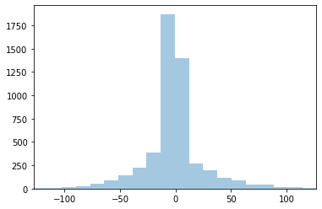
Statistical Analysis of EMG Distributions of Dataset vs Real-Time
Figure 1: Overall distribution of EMG readings of training samples for “marriage” gestures

Slide 67
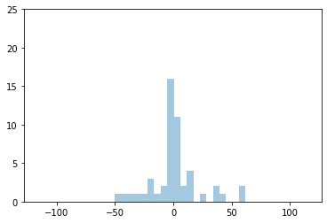
Statistical Analysis of EMG Distributions of Dataset vs Real-Time
Figure 2: Distribution of random training sample of “marriage” gesture (right prediction)

Slide 68
Statistical Analysis of EMG Distributions of Dataset vs Real-Time
Based on the overall distribution depicted in Figure 1, there is a “common case” sample that the neural network was trained with.
This “common case” sample is akin to the distribution in Figure 2.
It is apparent that most data points in the sample space were clustered within a specific region of bins. As the distribution leaves these bins, the number of instances get smaller.
This could mean that outliers in EMG were not accounted for very much in the sample space, which rings true as most if not all training samples for each gesture were taken at one point in time where the specimen’s general condition was the same throughout.

Slide 69
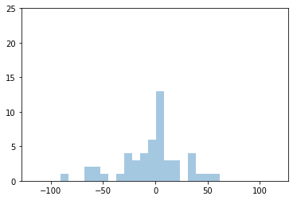
Statistical Analysis of EMG Distributions of Dataset vs Real-Time
Figure 3: “Marriage” performed with increased force (wrong prediction)

Slide 70
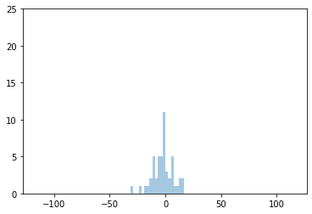
Statistical Analysis of EMG Distributions of Dataset vs Real-Time
Figure 4: “Marriage” performed after exercise (wrong prediction)

Slide 71
Comparing Real-Time Gestures vs Dataset
Figure 3 was collected from a gesture performed with more force (reflected in the wider distribution), and it was predicted incorrectly by the neural network.
Meanwhile, Figure 4 was collected from a gesture performed after exercise, and it was also predicted incorrectly by the neural network.
Although the circumstances behind when each gesture was performed were different, the baseline was that – in each circumstance – skin conductance was either increased or decreased, causing the EMG readings to move away from the EMG distribution that the neural network expected.
For Figure 3, skin conductance increased due to an increase in action potential. For Figure 4, sweat prevented sensors from making direct contact with the skin, thus dampening EMG readings.
In short, there is some evidence to the fact that variations in surface EMG – along with the lack of diversity in the sample space – could have adversely affected the neural network’s performance.

Slide 72
References
Colah, “Understanding LSTM Networks,” 2015. https://colah.github.io/posts/2015-08-Understanding-LSTMs/.
M. Hermans and B. Schrauwen, “Training and Analysing Deep Recurrent Neural Networks,” in Advances in Neural Information Processing Systems 26, C. J. C. Burges, L. Bottou, M. Welling, Z. Ghahramani, and K. Q. Weinberger, Eds. Curran Associates, Inc., 2013, pp. 190–198.
N. Srivastava, G. Hinton, A. Krizhevsky, I. Sutskever, and R. Salakhutdinov, “Dropout: a simple way to prevent neural networks from overfitting,” J. Mach. Learn. Res., vol. 15, no. 1, pp. 1929–1958, 2014.
C. Maklin, “Dropout Neural Network Layer In Keras Explained,” 2019. https://towardsdatascience.com/machine-learning-part-20-dropout-keras-layers-explained-8c9f6dc4c9ab.
S. Ioffe and C. Szegedy, “Batch normalization: Accelerating deep network training by reducing internal covariate shift,” arXiv Prepr. arXiv1502.03167, 2015.
E. Gatti, E. Calzolari, E. Maggioni, and M. Obrist, “Emotional ratings and skin conductance response to visual, auditory and haptic stimuli,” Sci. data, vol. 5, p. 180120, 2018.
M. Abdoli-Eramaki, C. Damecour, J. Christenson, and J. Stevenson, “The effect of perspiration on the sEMG amplitude and power spectrum.,” J. Electromyogr. Kinesiol. Off. J. Int. Soc. Electrophysiol. Kinesiol., vol. 22, no. 6, pp. 908–913, Dec. 2012, doi: 10.1016/j.jelekin.2012.04.009.
R. E. Mitchell, “How many deaf people are there in the United States? Estimates from the Survey of Income and Program Participation.,” J. Deaf Stud. Deaf Educ., vol. 11, no. 1, pp. 112–119, 2006, doi: 10.1093/deafed/enj004.
National Institutes of Health, “Quick Statistics About Hearing,” 2016. https://www.nidcd.nih.gov/health/statistics/quick-statistics-hearing.
C. Lou Garberoglio, S. Cawthon, and M. Bond, “Deaf People and Employment in the United States,” Washington, DC US Dep. Educ. Off. Spec. Educ. Programs, Natl. Deaf Cent. Postsecond. Outcomes, 2016.
S. Pizzolato, L. Tagliapietra, M. Cognolato, M. Reggiani, H. Müller, and M. Atzori, “Comparison of six electromyography acquisition setups on hand movement classification tasks,” PLoS One, vol. 12, no. 10, p. e0186132, 2017.

